Slide 1
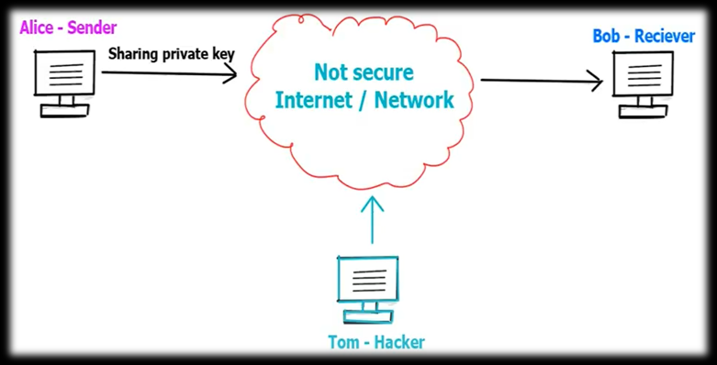
Diffie-Hellman Key Exchange Algorithm/Agreement
Symmetric Key Cryptography – The Problem of key Distribution

Slide 2
Diffie-Hellman Key Exchange Algorithm/Agreement
Diffie-Hellman Key Exchange algorithm is an advanced cryptographic method used to establish a shared secret key that can be used to perform secret communication on a public network.
The key exchange procedure has two steps :
One-time setup: Define some public parameters that are used by everyone forever.
Protocol: Run a two-message key exchange protocol to generate new secret keys. This process is done using some simple algebra, prime numbers, and properties of modular arithmetic.
Notes:
The Vigenère & related polyalphabetic ciphers still do not completely obscure the underlying language characteristics.
The key to breaking them was to identify the number of translation alphabets, and then attack each separately.

Slide 3
Algorithm
Alice and Bob agree on two large prime numbers, p and g, and a public key exchange algorithm.
Alice chooses a secret integer, a, and computes A = gª mod p. She sends A to Bob.
Bob chooses a secret integer, b, and computes B = g^{b} mod p. He sends B to Alice.
Alice computes k = Bª mod p. Bob computes k = A^{b} mod p.
Alice and Bob now both have shared secret keys, which they can use to establish a secure communication channel.

Slide 4
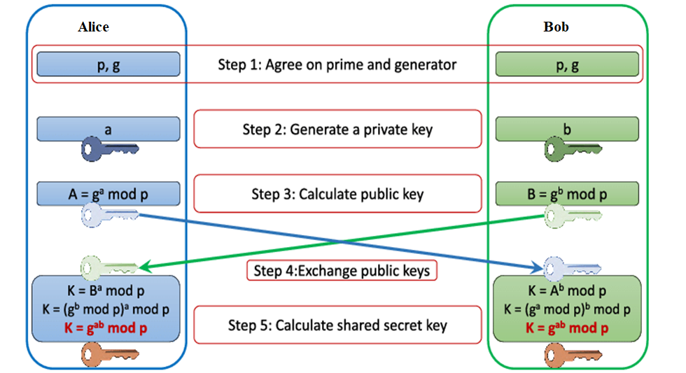


Slide 5
Example
Consider p = 353, g = 3 ( 3 is primitive root of 353)
A’s private key : a = 97
B’s private key : b = 223
Alice computes A = gª mod p = 3⁹⁷ mod 353 = 40
Bob computes B = g^{b} mod p = 3²²³ mod 353 = 248
After exchange of public keys,
each can compute the common secret key
Alice computes K = (B)ª mod p = (248) ⁹⁷ mod 353 = 160
Bob computes K = (A)^{b} mod p = (40) ²²³ mod 353 = 160

Slide 6
Try…
(1)
The value of P : 23
The value of G : 9
The private key a for Alice : 4
The private key b for Bob : 3
(2)
Prime no: 31981
Generator=6
A’s private key =817
B’s private key =23971
Notes:
9
K=7857

Slide 7
Solution
Solution of (1) :
The value of P : 23
The value of G : 9
The private key a for Alice : 4
The private key b for Bob : 3
Secret key for the Alice is : 9
Secret key for the Bob is : 9

Slide 8
Solution
Solution of (2)
Prime no: 31981
Generator=6
a=817
b random number-23971
A=16978B=28349
K=7857

Slide 9
Security Threat of the Diffie-Hellman
Let’s assume that the eavesdropper knows the public values p and g and with all her knowledge, she still can’t compute the secret key k, as it turns out, if p and g are properly chosen, it’s very, very hard for her to do.
For instance, you could brute force it and try all the options, but the calculations (mod p) make the discrete log calculation super slow when the numbers are large.
Even with its immunity to brute force, it’s vulnerable to MITM (man in the middle position).

Slide 10
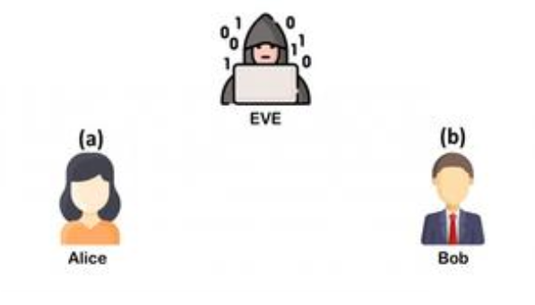
Man In Middle Attack (MITM)
Step 1: Selected public numbers p and g, p is a prime number, called the “modulus” and g is called the base.
Step 2: Selecting private numbers
Let Alice pick a private random number a and let Bob pick a private random number b, Malory picks 2 random numbers c and d.

Slide 11
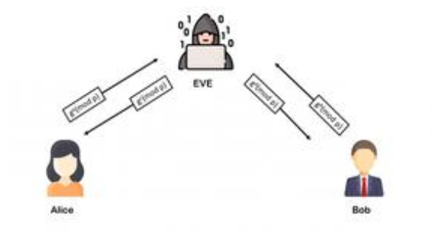
Step 3: Intercepting public values,
Malory intercepts Alice’s public value (gª(mod p)), block it from reaching Bob, and instead sends Bob her own public value (g^{c}(modp)) and Malory intercepts Bob’s public value (g^{b}(mod p)), block it from reaching Alice, and instead sends Alice her own public value (g^{d} (modp))

Slide 12
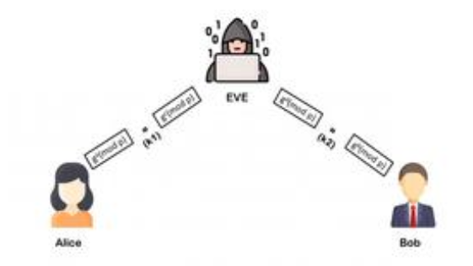
Step 4: Computing secret key
Alice will compute a key S₁=g^{da}(mod p), and Bob will compute a different key, S₂=g^{cb}(mod p)

Slide 13
Step 5: If Alice uses S₁ as a key to encrypt a later message to Bob, Malory can decrypt it, re-encrypt it using S₂, and send it to Bob.
Bob and Alice won’t notice any problem and may assume their communication is encrypted, but in reality, Malory can decrypt, read, modify, and then re-encrypt all their conversations.

Slide 14
